Slide 1
Yule Distribution
Connie Qian
Grant Jenkins
Katie Long
Notes:
connie

Slide 2
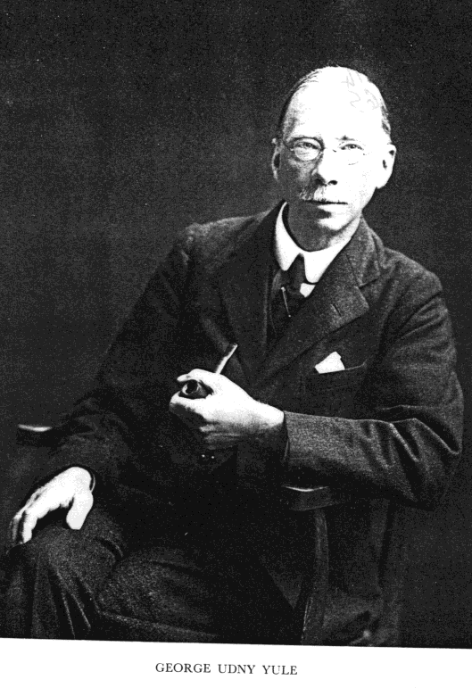
Outline
Introduction
Definition, parameters
PMF
CDF
MGF
Expected value, variance
Applications
Empirical example
Conclusions
Notes:
connie

Slide 3
Introduction
Yule (1924) “A Mathematical Theory of Evolution…”
Simon (1955) “On a Class of Skew Distribution Functions”
Chung & Cox (1994) “A Stochastic Model of Superstardom: An Application of the Yule Distribution”
Spierdijk & Voorneveld (2007) “Superstars without talent? The Yule Distribution Controversy”
Notes:
connie
In 1925 Yule published the paper "A Mathematical Theory of Evolution, based on the Conclusions of Dr. J. C. Willis, F.R.S.",^{[3]} where he proposes a stochastic process that leads to a distribution with a power-law tail — in this case, the distribution of species and genera. This was later called the Yule process, but is now better known as preferential attachment. Herbert A. Simon dubbed the resulting distribution the Yule distribution in his honor.
Chung & Cox uses the Yule dist and found that the distribution fit the empirical data in the popular music industry. This implies that the superstar phenomenon follows a stochastic model, instead of being dependent on talent. → superstar phonomenon could exist among individuals with equal talent (politicians, atheletes, actors, singers)

Slide 4

Definition
Brief History
Discrete Probability Distribution
p.m.f: $f\left(x\right)=ρ∗B(x,ρ+1)$ where x$≥1$
$ρ>0$
Beta Function:
$$B\left(x,ρ+1\right)=\int_{0}^{1}{λ^{t−1}{(1−λ)}^{ρ}}dλ=\frac{Γ(x)Γ(ρ+1)}{Γ(x+ρ+1)}$$
c.d.f: $F\left(x\right)=1−x∗B\left(x,ρ+1\right)$
Notes:
Katie
1. Yule started constructing this distribution by analyzing specific mutation within each genus.
He assumes that in each genera, the prime species can create a new species of the same genus with fixed probability p
So suppose there are N prime species all of different genera, then after infinite time, Yule discovers a geometric distribution of the number of species in the genus.
The same method can be applied to the number of genera in each family and he concludes that this random variable also has a geometric distribution.
2. Let X represents the number of species in genus across all ages after infinite time. f(x) is a frequency distribution.
In other words, this distribution wants to know how likely a genus will end up with x different specifies across all ages after infinite time.
In the superstardom example that we will explain later, f(i) represents the probability that a performer will end up with I gold-records after some period of time.

Slide 5
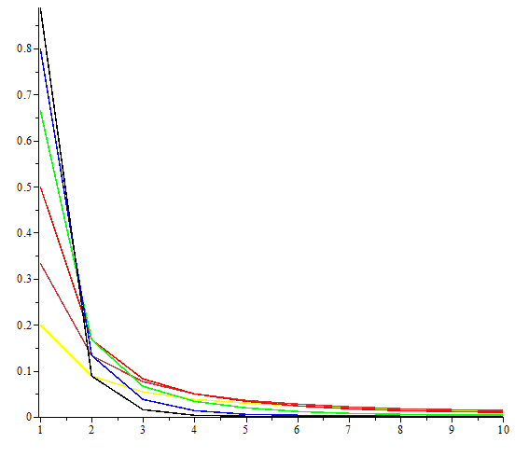
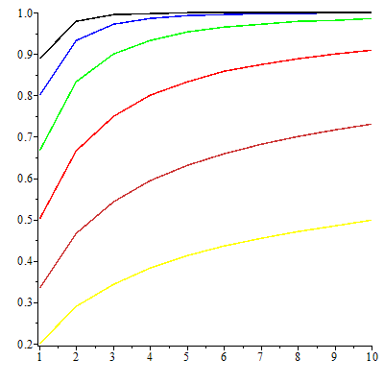

Graphs of p.m.f and c.d.f
(Discrete Distribution!)
P.M.F.
C.D.F.
$ρ$=0.25, 0.5, 1, 2, 4, 8
Notes:
From bright to dark color, the value of rho increases.

Slide 6

Parameters of the general Yule Distribution
E[X] =$\frac{ρ}{ρ−1}$, $ρ$>1
Var[X] = $\frac{ρ^{2}}{{\left(ρ−1\right)}^{2}(ρ−2)}$
M.G.F. =$\frac{ρ}{ρ+1}(\sum_{n=0}^{∞}{\frac{{(1)}_{n}{(1)}_{n}}{{(ρ+2)}_{n}}∗\frac{e^{tn}}{n!})e^{t}}$
  Pochhammer Symbol
Notes:
grant

Slide 7
Applications
Distribution of words by their frequency of occurrence
Distribution of scientists by the number of papers published
Distribution of cities by population
Distribution of incomes by size
Distributions of biological genera by number of species
Distribution of consumer’s choice of artistic products
Notes:
connie

Slide 8
Superstar phenomenon (Chung & Cox)
Small number of people have a concentrate of huge earnings
Low supply, high demand
Does it really have to do with ability (talent)?
If not, then the income distribution is not fair!
There are many theories of why only a few people succeed (Malcolm Gladwell, anyone?)
Chung & Cox predicts that success comes by LUCKY individuals, not necessarily talented ones
Notes:
connie

Slide 9



Yule Process
persons
1
records
2
3
4
$$⋮$$
Notes:
connie
-Each person purchases different records each time
-Yule assumptions
Each consumer buys the same number of records
The probability that a new consumer chooses a record that was already chosen is proportional to the probability that the number of old consumers who have chosen the record → indicates network effect
There is a constant probability that new records are chosen

Slide 10

Superstar Example (empirical analysis)
Prediction of number of gold-records held by singers of popular music
# of Gold-records indicates monetary success
Yule distribution is a good fit when $ρ=1$ (this means that the probability that a new consumer chooses a record that has not been chosen is zero)
Notes:
connie

Slide 11

Superstar example continued
$f\left(i\right)=ρB(i,ρ+1)$
Recall that $B\left(x, y\right)=\frac{Γ(x)Γ(y)}{Γ(x+y)}$
$ρ$=$\frac{1}{(1−δ)}$ and δ≈0, so $ρ$ ≈ 1
f(i) = B(i, 1+1), i=1,2,…
  =$\frac{Γ(i)Γ(1+1)}{Γ(i+2)}= \frac{1!\left(i−1\right)!}{\left(i+1\right)!}= \frac{\left(i−1\right)!}{\left(i+1\right)i\left(i−1\right)!}=\frac{1}{i\left(i+1\right)}$
F(x) = $\sum_{1}^{x}{\frac{1}{\left(i+1\right)i}= }\frac{x}{x+1}$
Notes:
grant

Slide 12

Superstar Example Parameters
E[X] does not exist
  $\sum_{i=1}^{∞}{\frac{i}{i(i+1)}=}\sum_{i=1}^{∞}{\frac{1}{(i+1)}}$
  Harmonic Series
Var[X] does not exist
M.G.F. =$\frac{1}{2}(\sum_{n=0}^{∞}{\frac{{(1)}_{n}{(1)}_{n}}{{(3)}_{n}}∗\frac{e^{tn}}{n!})e^{t}}$
Notes:
grant

Slide 13

Alternative Measures of Center
Median of X
  $\frac{1}{2}=\frac{x}{x+1} \overset{⇒}{}x=1$
Mode of X
  Max($\frac{1}{i(i+1)})$
  $0=\frac{dy}{di}\frac{1}{i(i+1)}\overset{⇒}{}0=\frac{−2i+1}{{[i\left(i+1\right)]}^{2}}\overset{⇒}{}\frac{1}{2}=i$
  Nearest integral to ½ is 1
Notes:
grant

Slide 14
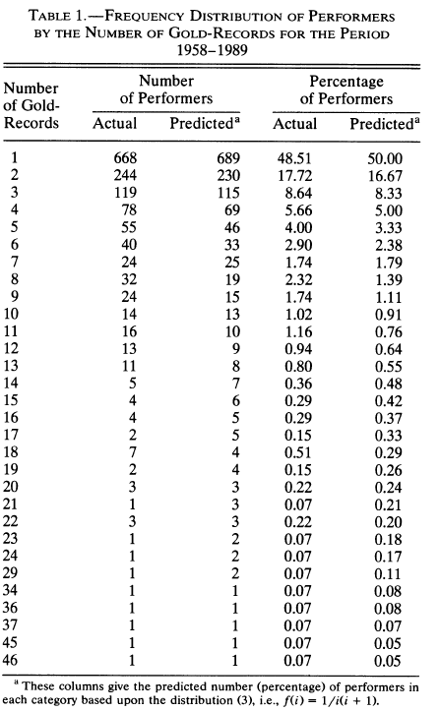
Source: Chung & Cox (1994)
Notes:
connie

Slide 15

Criticisms
$ρ$ =1 is implausible
  Because it requires that δ=0
Yule distribution with beta function doesn’t fit the data well
  Generalizes Yule distribution using incomplete beta fits the data better
Notes:
grant

Slide 16

Conclusions
Yule distribution applies well to highly skewed distributions
But finding the Yule distribution in natural phenomena does not imply that those phenomenon are explained by the Yule process
Notes:
connie

Slide 17
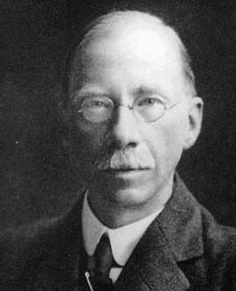
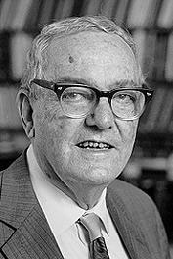
Thanks! Questions?
Notes:
connie

